Slide 1

From Melange to Meaning: IRS Form 990
Sean Connin
Data 607 Final Project

Slide 2


Slide 3
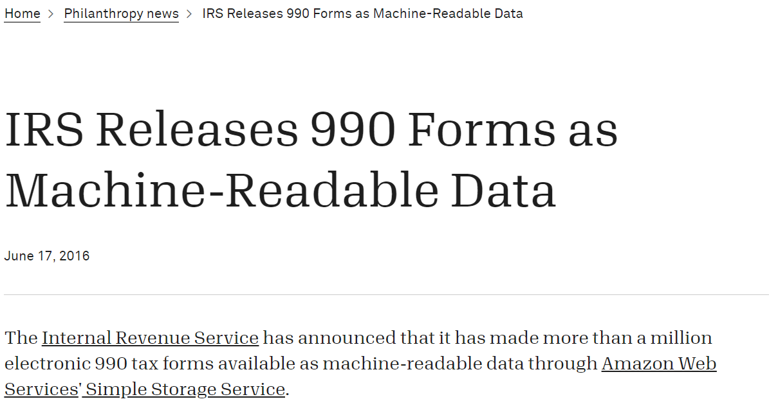
Adapted from Candid: https://bit.ly/3fcgIZD

Slide 4
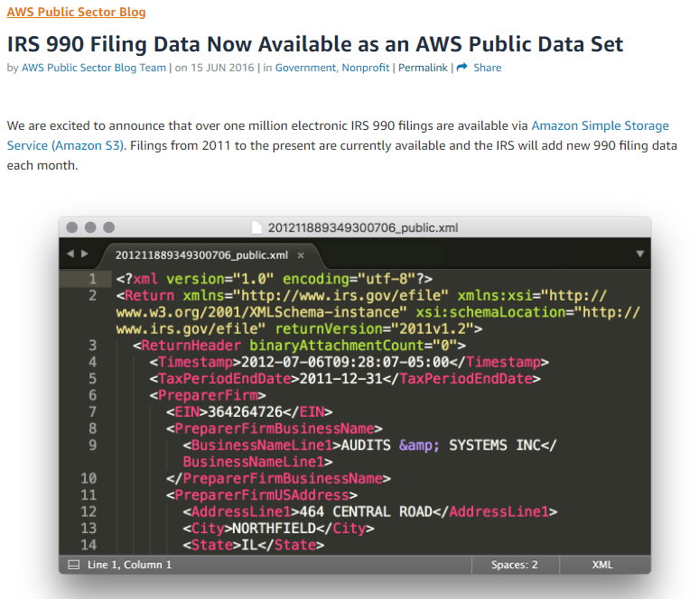
https://amzn.to/3hyOnzJ

Slide 5

IRS Form 990
Part I: EOY financial summary
Part III: Key program service accomplishments
Part VI-VII: Leadership and compensation
Part VIII: Statement of Revenue
Part IX: Statement of Expenses
Part X-XI: Balance and Reconciliation
Adapted from: https://bit.ly/3oecXXU

Slide 6
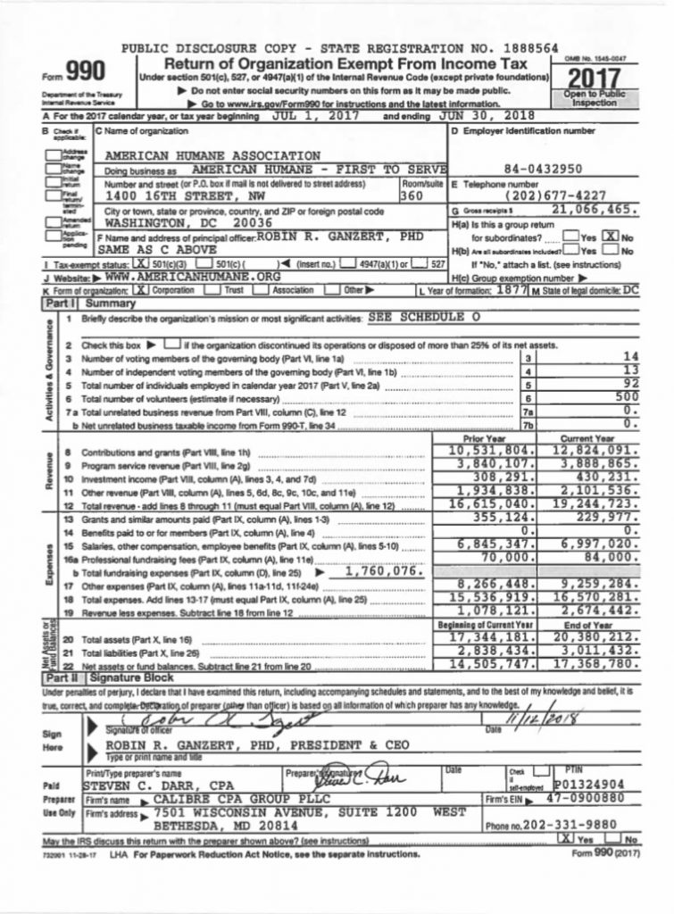
IRS Form 990

Slide 7

AWS XML Form 990
IRS Indices
Filed via. random id
JSON and CSV: unequal capture, often empty or updated at different times
XML
Changing version schema with tax code updates and form changes
Multiple lines for same field information – glue and stitch
Non-equivalent roots for same data
Field definitions different from paper form
Adapted from: https://bit.ly/3oecXXU

Slide 8
IRS Form 990
990 Nonprofits with ≥ $50,000 in gross receipts.
990EZ Nonprofits with ≤ $200,000 in gross receipts
and assets ≤ $500,000
990PF Foundations and Charities
Adapted from: https://bit.ly/3oecXXU

Slide 10
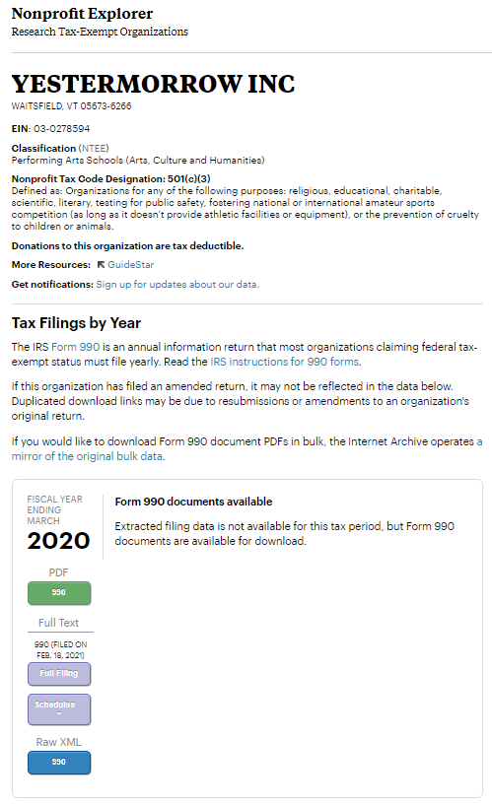

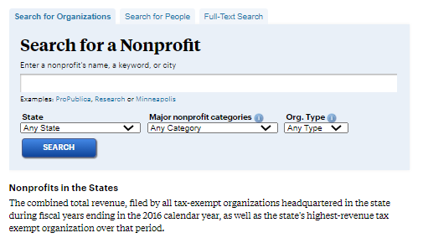
https://projects.propublica.org/nonprofits/organizations/30278594

Slide 11
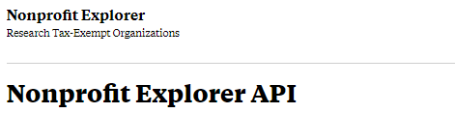
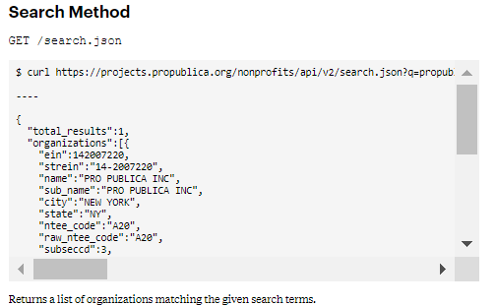
https://projects.propublica.org/nonprofits/api

Slide 12
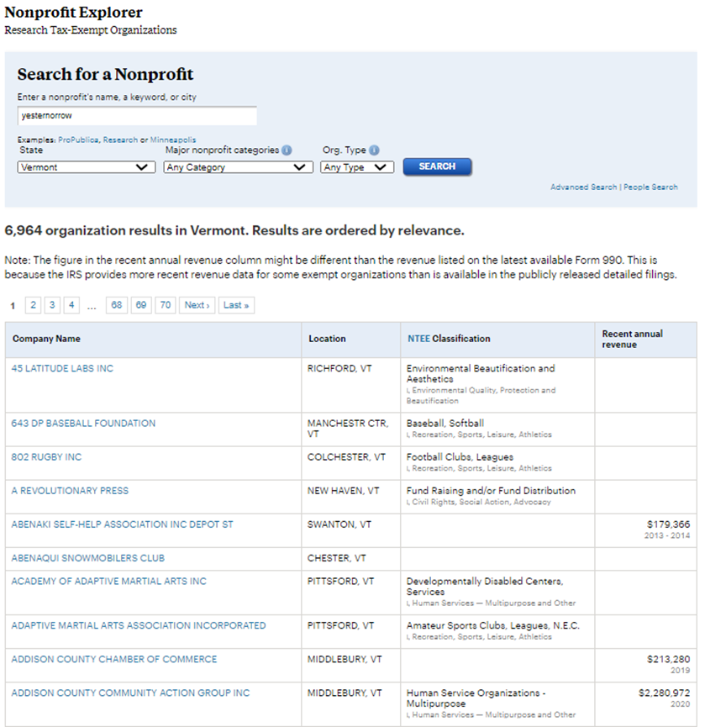
https://projects.propublica.org/nonprofits/organizations/30278594

Slide 13
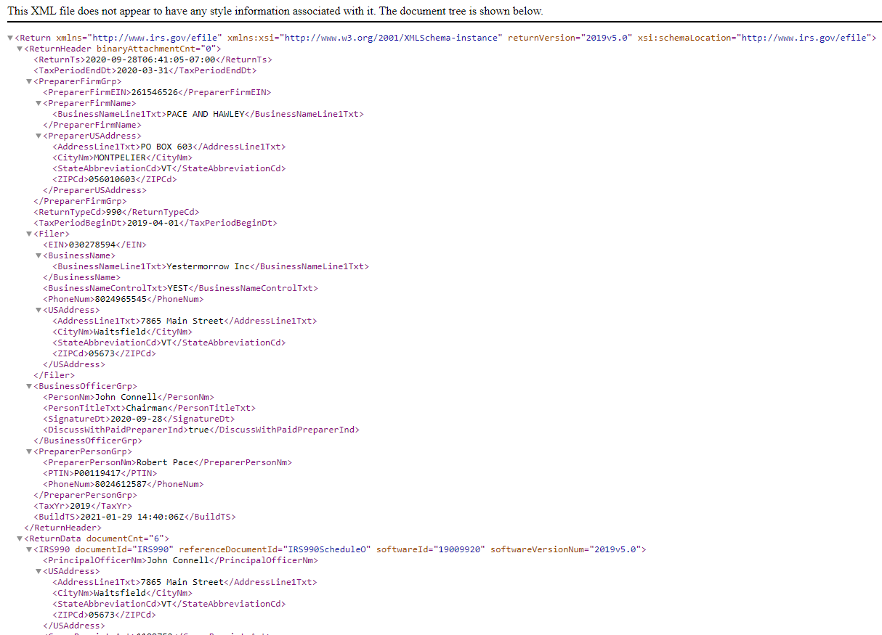

Slide 14
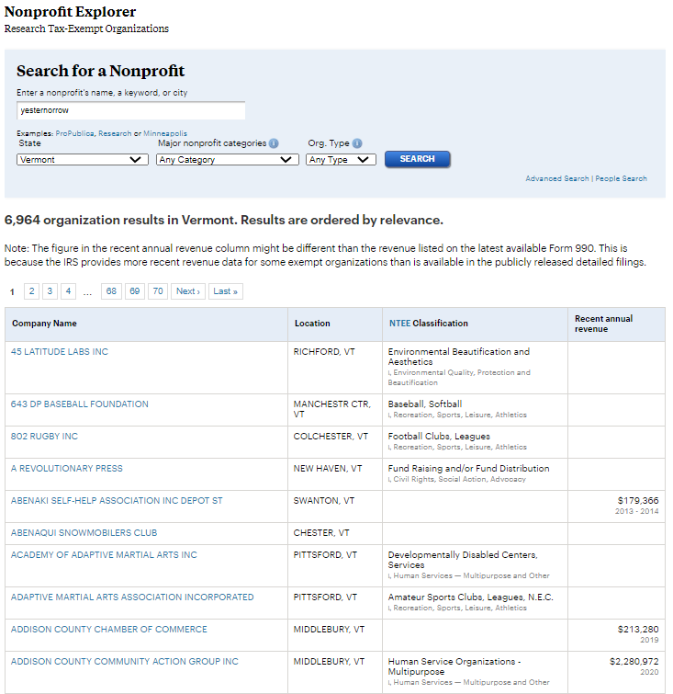
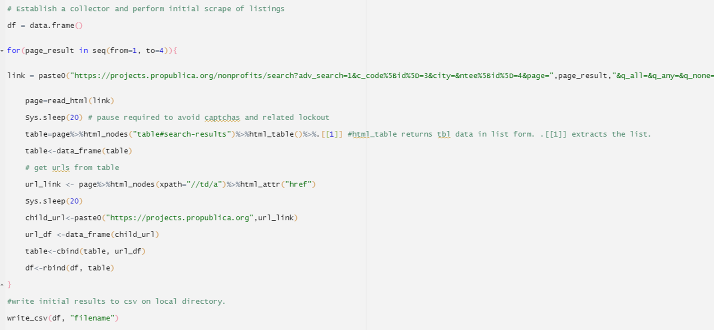

Slide 15
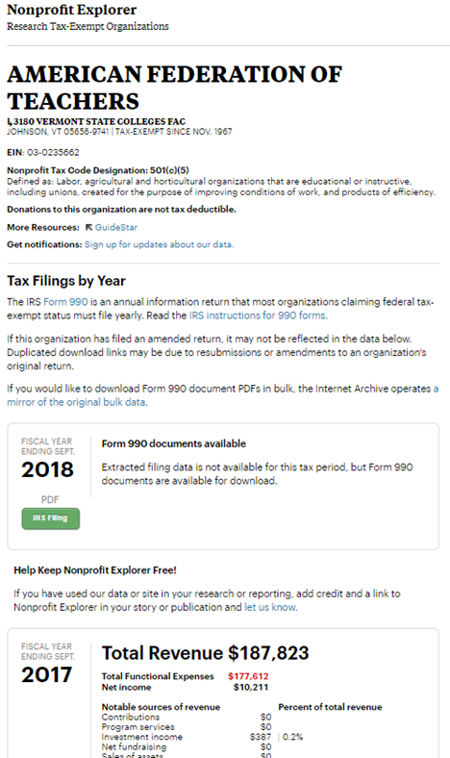
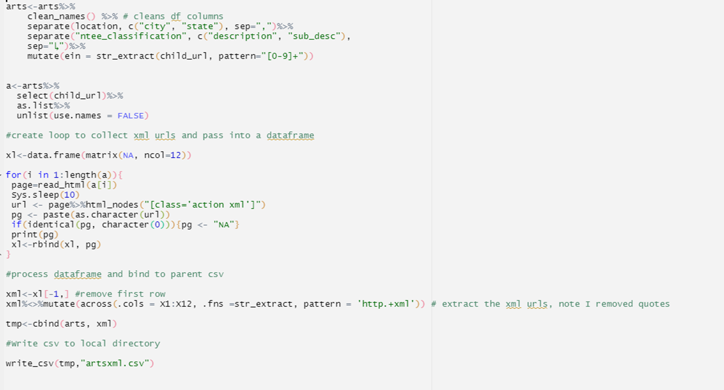

Slide 16
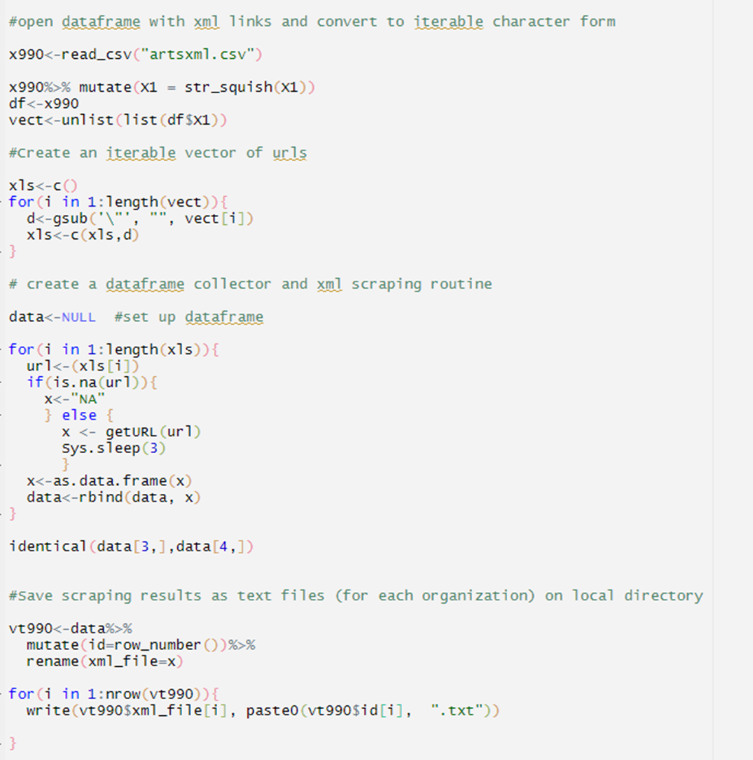
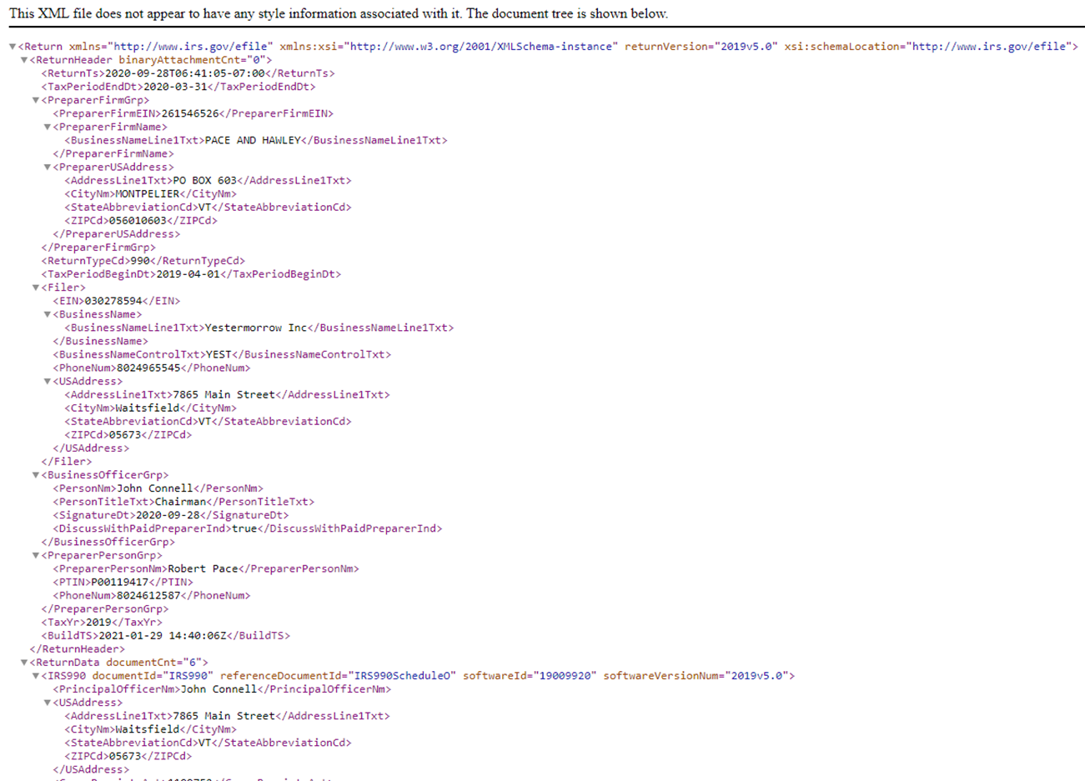

Slide 17
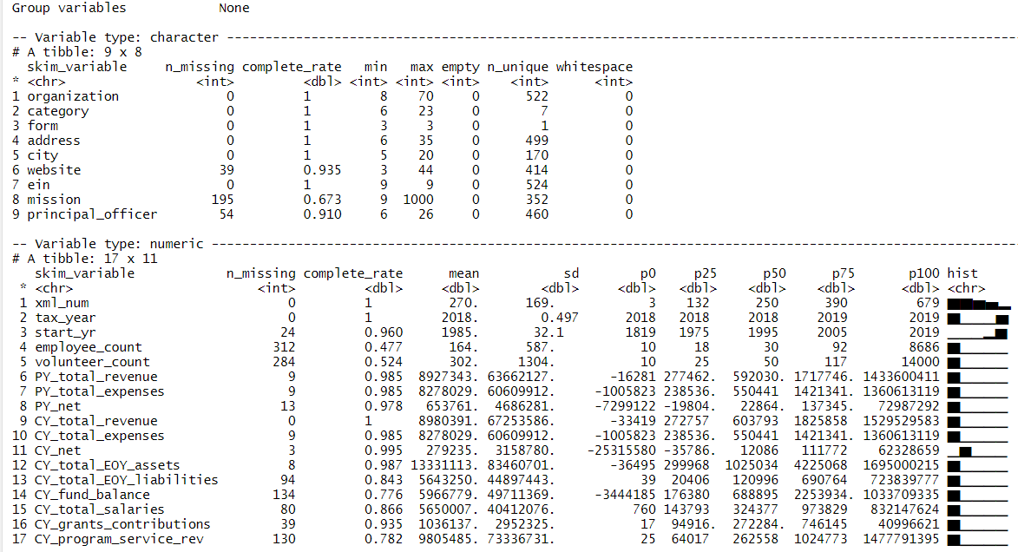

Slide 18
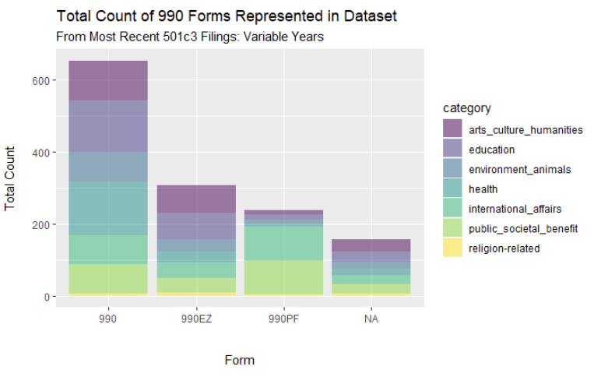

Slide 19
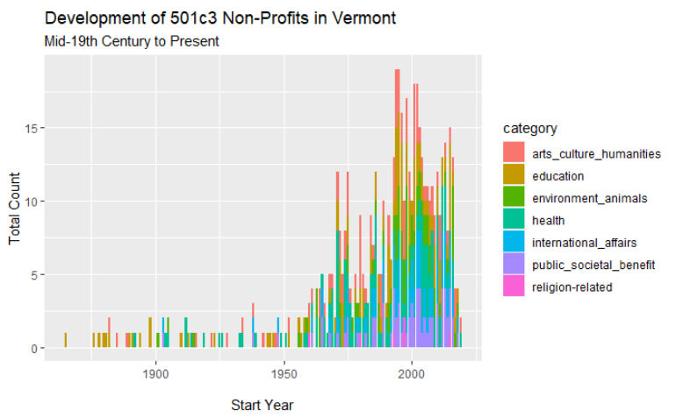
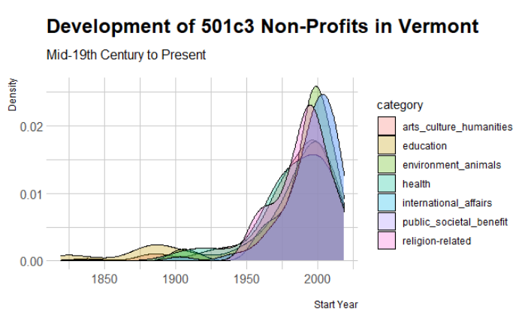

Slide 20
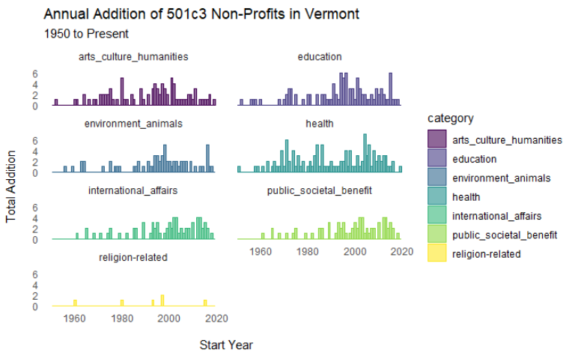
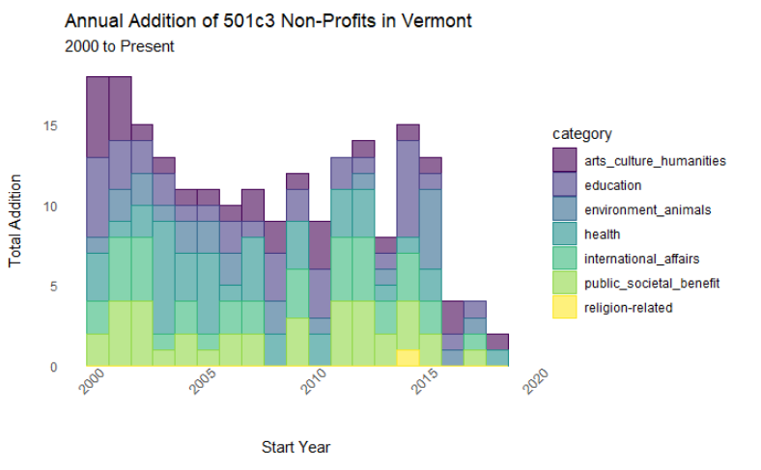

Slide 21
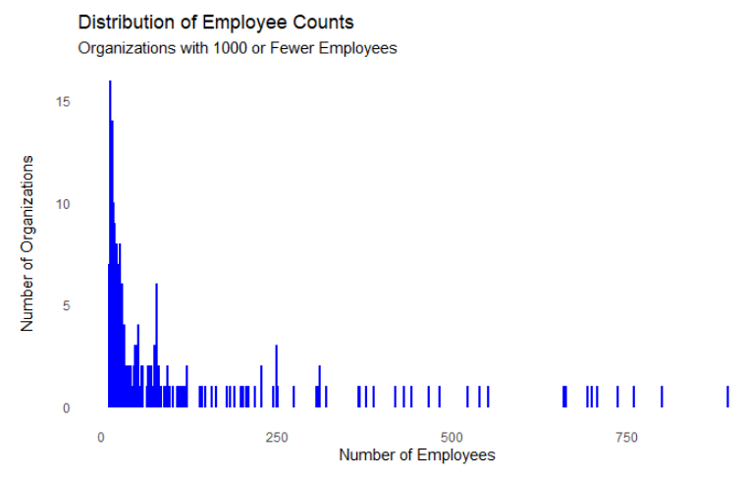
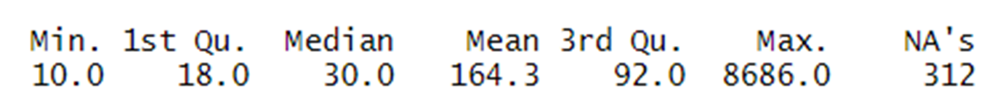

Slide 22
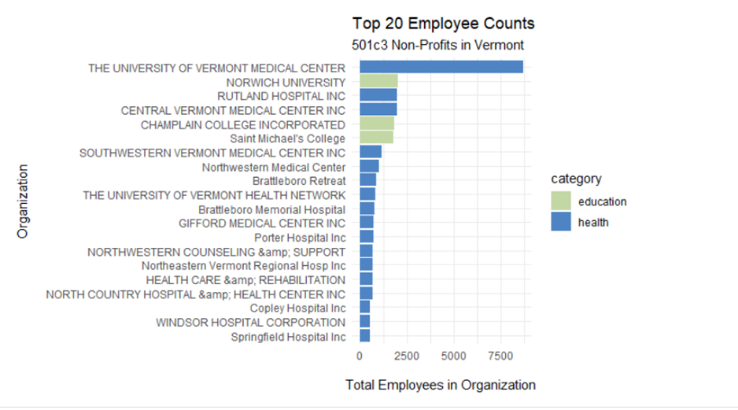

Slide 23
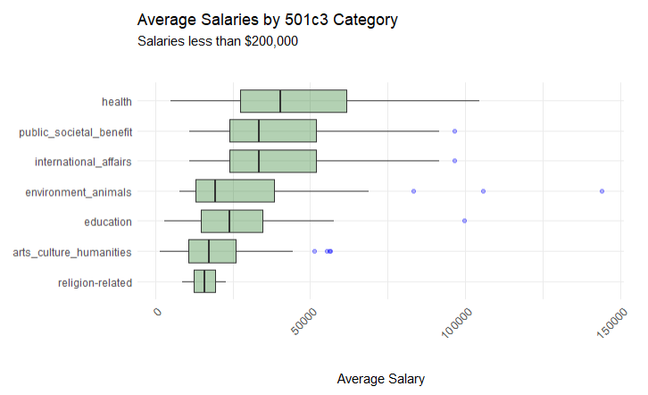

Slide 24
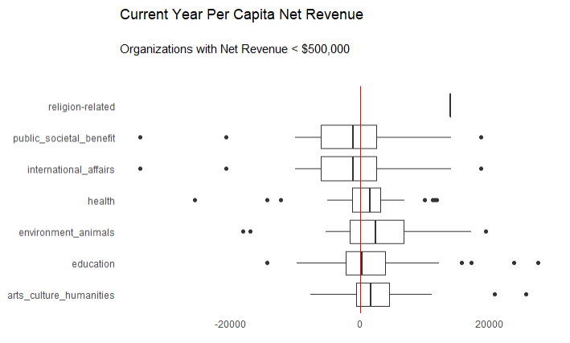

Slide 25
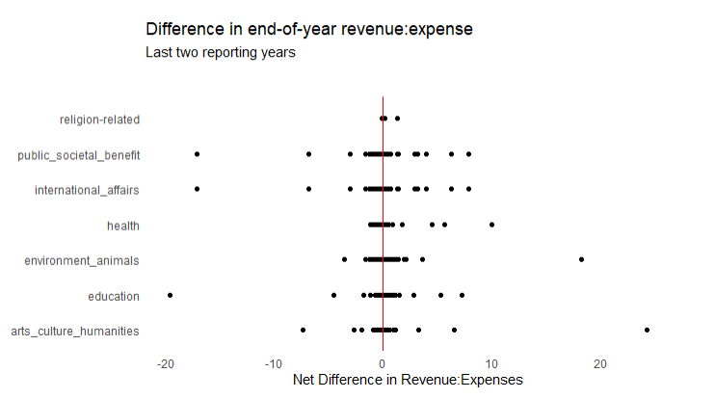

Slide 26
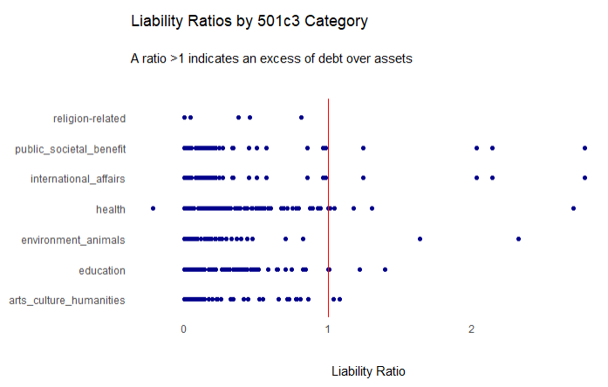
A ratio < 1 indicates an excess of debt over assets

Slide 27
Challenges
Heterogeneity of available data
Repetition of information (data extraction)
Form sections and schedules
Processing time and data management
Quality control
Adapted from: https://bit.ly/3oecXXU

Slide 28
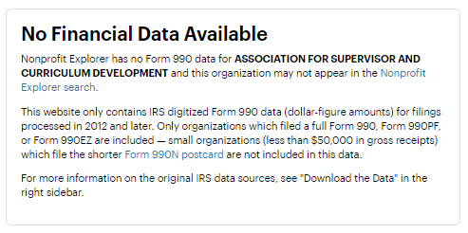

Slide 29
Opportunities – data prospecting
Data as service
API’s
Facilitated Collaboration
Research – organizational leadership etc.
Adapted from: https://bit.ly/3oecXXU

Slide 30
Next Steps
990, 990EZ, 990PF
Form sections and schedules
Organizational Leadership
Additional metrics
Salary and fringe ratios
Primary reserve ratio
Viability ratio
Debt equity ratio
Program expense ratio
Administrative ratio
Fundraising ratio
Adapted from: https://bit.ly/3oecXXU

Slide 34
https://projects.propublica.org/nonprofits/organizations/30278594

Slide 35
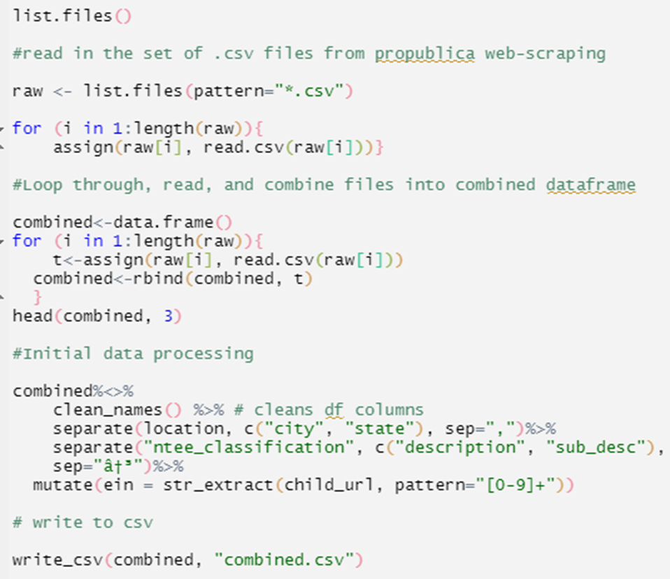

Slide 37
